Slide 1



Nashville City Cemetery Marketing Materials
Phoenix Slone

Slide 2

01
02
03
Cleaning Process
Historical: Fun and Games
04
Year with the Highest Number of Burials
Months with the Highest Number of Burials

Slide 3
Cleaning Process
Pro | Pro | Pro
Filtering and sorting the data to condense the information given by removing duplicates. | By cleaning the data, the results are able to sorted and viewed in a more time effective manner. | Clean data equals valuable results.
No Duplicates | Time Efficient | Valuable Results

Slide 4
All Fun and Games
Tree Contest
T
S
Scavenger Hunts
Annual Weed Wrangling
M
T
Tours
5 trees won Nashville Tree
Foundation’s “Big Old Tree
Contest” in 2011
First person to find all items on the given list is ensured to win a grand prize
Second Saturday tours around the historical 27 acre lot
Each year they hope to Roundup enough volunteers to help keep the cemetery clean

Slide 5
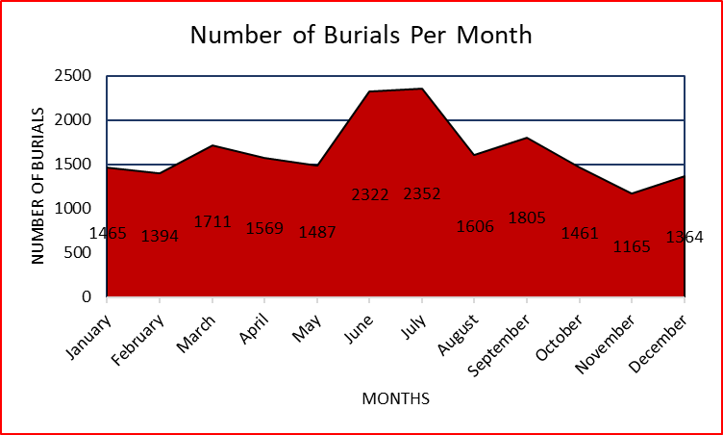
Month: Highest Number of Burials
JULY
2,352 Burials
JUNE
2,322 Burials
-Exposure to hotter temperatures cause bacterial and viral infections to thrive.
-Cooler temperatures kill off bacteria
-Warmer temperatures incubate bacteria
-There are limitations

Slide 6
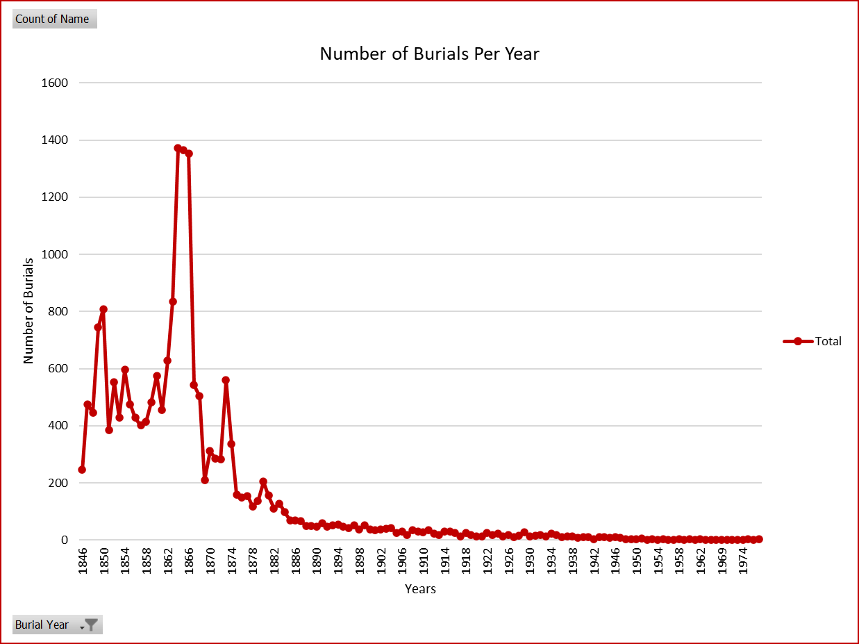
Year: Highest Number of Burials
1,372
Burials in 1864
The likelihood of the extensive number of deaths is predicted to have been a result of the American Civil War (1861-1865).

Slide 7
Takeaways
-Nashville is a large city and growing every minute of every day!
-We as people should learn from history and not forget it
- War causes death as well disease
-Death is typically looked at in a sad demise, but it can also be extremely honorable.

Slide 8

Do you have an questions?
THANK YOU!
Credits:
Slidesgo (Format of this Presentation)
Nashville City Cemetery (Data)
Nashville Software School

